Slide 1
Standard User – Event Notifications
February, 2013

Slide 2

Learning Objectives
Upon completion of this course you will be able to:
Schedule an Event
View an Event
Delete an Event
Define Notification Properties
Define Notification Recipients
Send an Immediate Notification of an Event

Slide 3

Event Notifications
Pre-defined Notifications about contract events such as expiration dates can be scheduled and associated with the Contract Template.
However, as the contract author, if you have the correct permissions, you can set up your own event notifications for a specific contract.
In addition, you can send immediate, pre-defined notices to other members of the team.

Slide 4
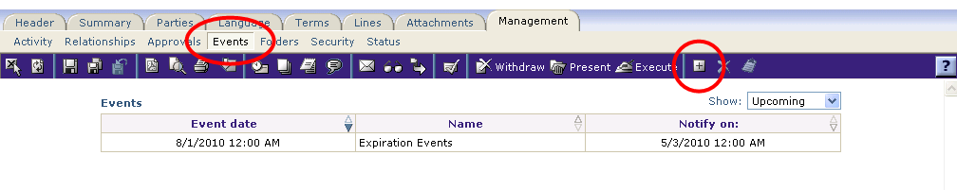
Schedule Events
As the contract author, you may wish to set up a notice about certain contract-related events.
To create an event notification, click the Management tab > Events sub-tab.
The pre-defined events scheduled for this contract are displayed.
Click the Add Event icon (small plus sign) on the main, blue toolbar.
The New Contract Event dialog box is displayed.

Slide 5
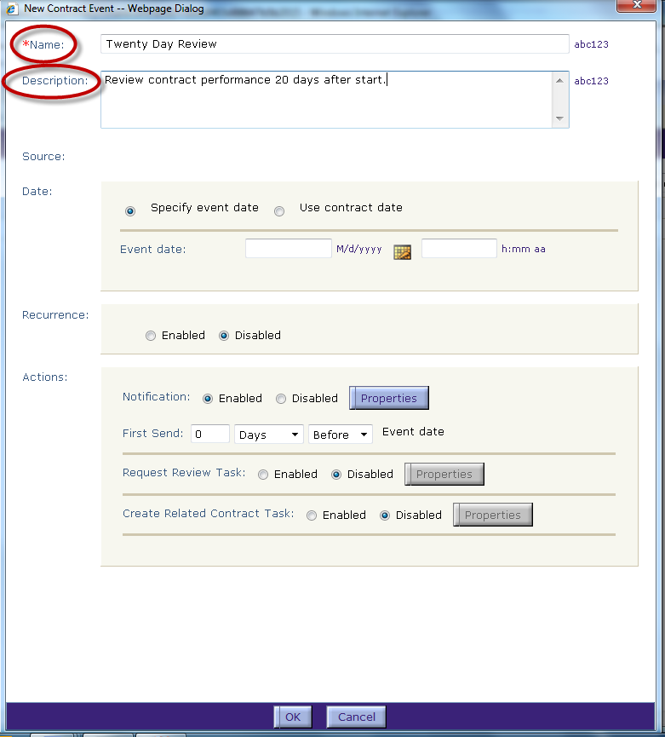
Schedule Events – Name and Description
Enter a Name for the event.
  For this example, we want to be notified so that we can hold a meeting to review the contract performance.
Enter a Description.

Slide 6
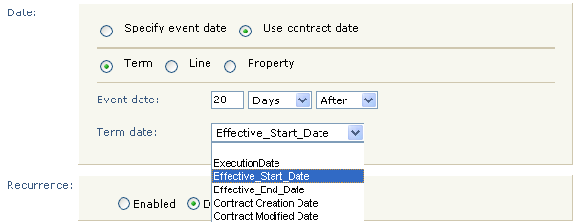
Schedule Events – Date and Recurrence
The usual practice is to choose a Term that represents a date in the life of the contract, possibly offsetting it by a duration before or after
  In this example, we identify that we want to know when 20 days have passed after the Effective Start Date for the contract.
  Can also use a date from a Line or a Property, or an “event date” (a hard-coded calendar date)
Click the radio button to select a specific date (“event date”) or link the event to a pre-defined “contract date”. In this example, we select a contract date.
Click the radio button to identify where the pre-defined date can be found in the contract: a Term, Line, or Property.
Enter the number of days (weeks, months, etc) before or after the selected date.
Identify the selection criteria (before or after).

Slide 7
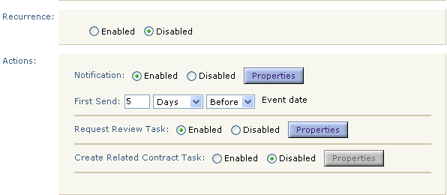
Schedule Events – Notification Actions
Enable Recurrence to specify when a notification pattern should be repeated. Recurrence is disabled by default.
  If enabled, select the recurrence pattern from days, weeks, months and years and enter a number for the same. Thereafter, specify the end of the recurrence pattern.
Since it can take some time to set up a meeting, enter the amount of days you would like to receive the email notice before the contract event will occur.
In the Notification section, identify the number of days (weeks, months, etc.) and criteria (before or after) that you would like to receive the notice.
  For this example, we enter “5 days before” the event date.
Click the Properties button to select the recipients and notification template.

Slide 8
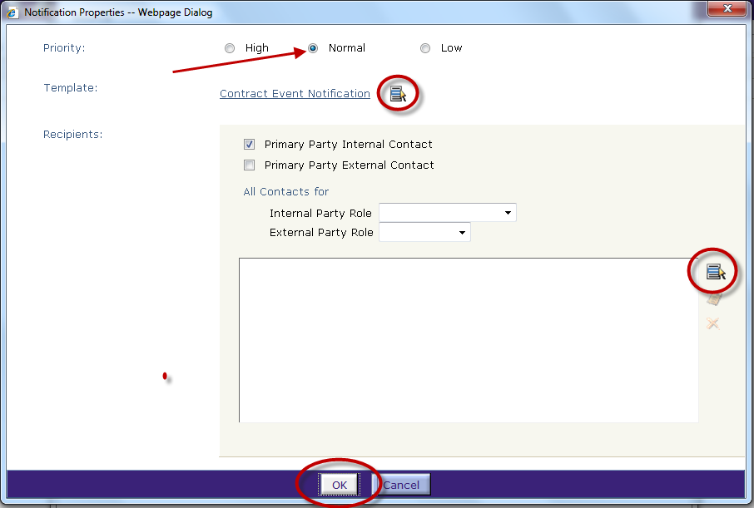
Schedule Events – Priority, Template, Recipients
Set the email Priority level for this notice (High, Normal or Low).
The default notification template is displayed.
  Use the Select icon to select a different template.
Click the check boxes for the Internal and External Recipients.
Add other Internal or External Recipients by selecting the role from the drop down menus.
Click the Select icon to add other recipients to the notice. Click OK when done.

Slide 9
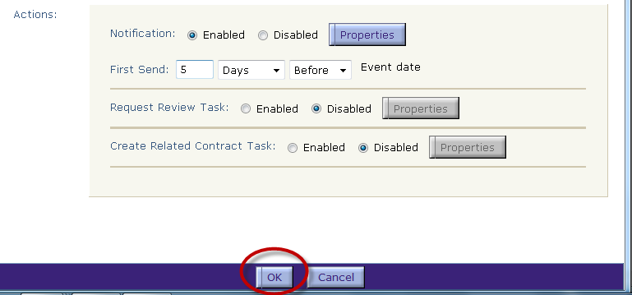
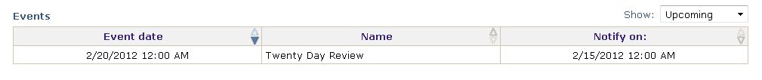
Schedule Events – Review Task and Schedule Event
You can include a related Review Task with the event notification and create a Related Contract Task for this event.
  By default, these options are disabled (and the latter is not recommended).
After editing the notification properties, click OK to schedule this event notification. The event is added to the list.

Slide 10
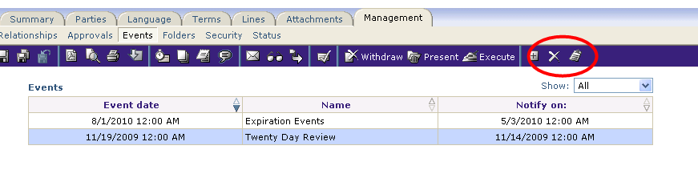
Delete and View Events
To delete or review an event notification:
Click in the row to highlight the event name.
Click the Delete or View icon to remove this event, or view and edit the event properties.

Slide 11
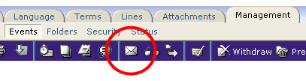
Send Immediate Notifications
You can send an immediate notification from any tab of the Contract Editor.
Click the Send Notification icon on the main, blue toolbar.
The Notification Properties dialog box is displayed.

Slide 12
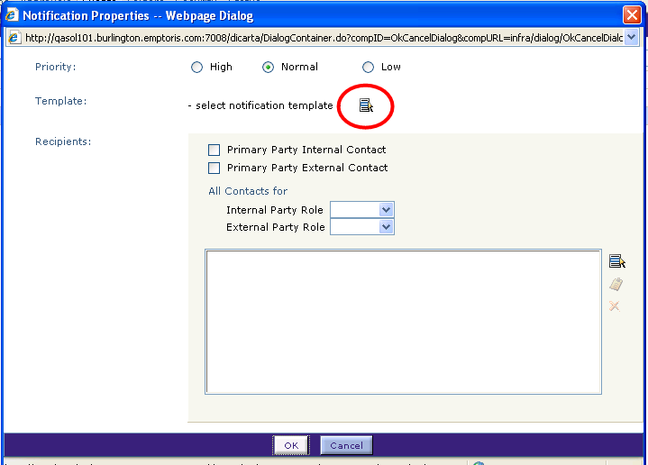
Notification Properties
Set the email Priority level radio button for this notice.
Identify the message template to be used in the Notification by using the Select icon to display a list of notification templates.
  The Select Notification Template Dialog Box is displayed.

Slide 13
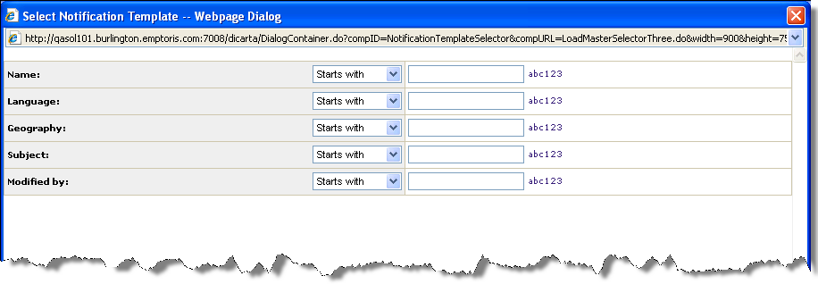
Select Notification Template Dialog Box
Enter a template name or partial name.
Or, leave all fields blank to display a list of all available templates.
Click Find. The list of templates is displayed.

Slide 14
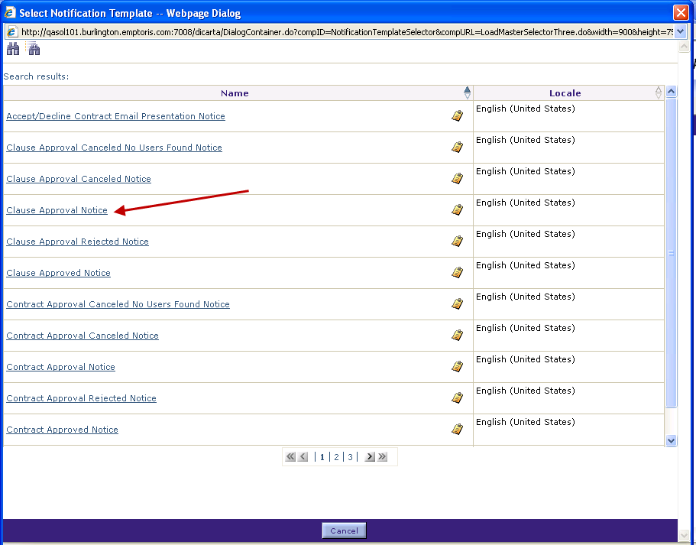
Select Notification Template Dialog Box, cont.
Navigate to the page to find the template name.
Click the name hyperlink to select the template.
The template is displayed on the Notification Properties dialog box.

Slide 15
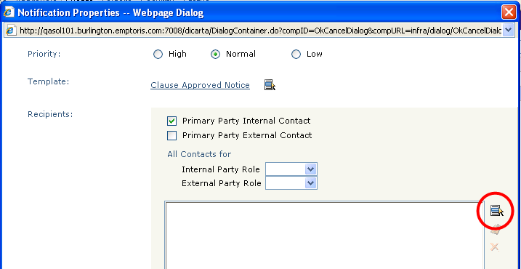
Notification Properties Dialog Box
Identify the recipients for the notification:
Click the boxes to indicate if the Internal contact and/or External contact is to receive the notification.
Click the Select icon to add additional recipients to the list.
The Select Individual dialog box is displayed.

Slide 16
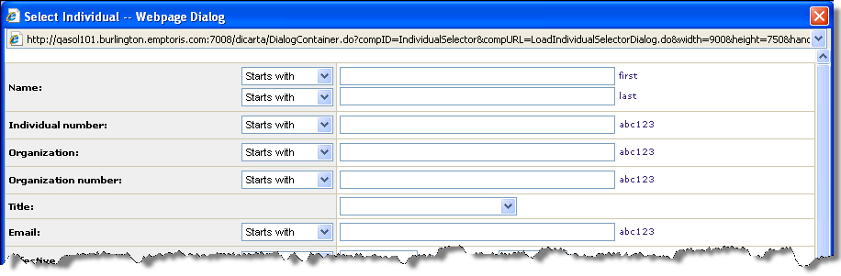
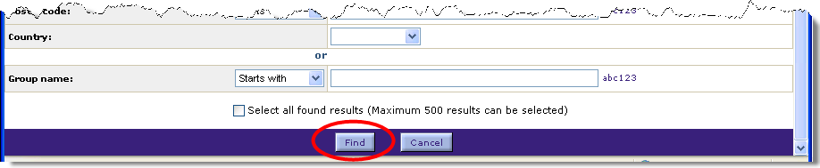
Select Individual Dialog Box
Enter a name or partial name in any of the fields.
Or, leave all fields blank to display a list of all available individuals.
Click Find.

Slide 17
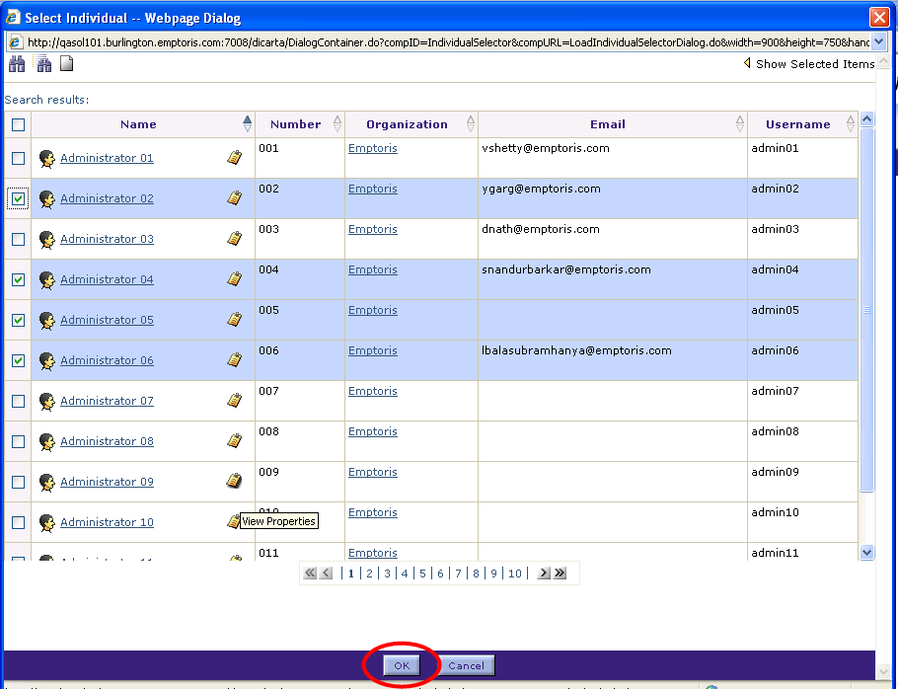
Select Individual Dialog Box, cont.
The list of individuals matching the criteria is displayed.
  Navigate to the page with the appropriate name.
Click the check box next to a user’s name, or click in the row to highlight an individual’s name.
Continue selecting individuals as needed to build the recipients list.
Click OK when done.
The list of recipients is added to the Notification Properties dialog box.

Slide 18
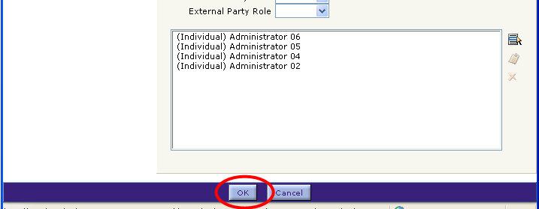
Select Individual Dialog Box, cont.
Click OK to send this notification to the listed recipients.

Slide 19

Questions?

